Slide 1


Mr. Volted
AI Chatbot for Electrical Engineering
By:
Shreerang Mhatre
Sarvesh Gurav

Slide 2
Contents:
Introduction
Objective
Block diagram
Methodology
Tech Stacks
Conclusion
References

Slide 3
Introduction
"Introducing 'Mr.Volted,' an innovative chatbot designed to revolutionize the field of electrical engineering. Mr.Volted is equipped with a vast repository of locally curated data, providing lightning-fast and accurate answers without relying on internet sources. Its primary focus is to serve as an indispensable tool for both learners and researchers, simplifying access to critical electrical engineering knowledge. Our research question aimed to optimize knowledge accessibility for Student learning. We achieved this by integrating advanced AI models from Langchain and OpenAI for natural language understanding and generation. 'Mr.Volted' is poised to enhance the learning experience and accelerate research in electrical engineering, offering a reliable, locally sourced knowledge hub for enthusiasts and professionals alike."

Slide 4
Objectives
Knowledge Accessibility
User-Friendly Interface
01
02
Educational Impact
Advanced Natural Language Processing (NLP)
04
03
Users can quickly and easily access accurate electrical engineering information from the local database, promoting efficient learning and research.
An intuitive and user-friendly chatbot interface that accommodates both novice learners and seasoned researchers, making information retrieval seamless.
Tracking its usage among learners, educators, and researchers to quantify its contribution to the field of electrical engineering
Implemented and optimized Langchain and OpenAI's NLP models to enhance the chatbot's ability to understand and respond to user queries effectively.
Research Acceleration
06
Comprehensive Data Repository
05
Evaluate how "Mr.Volted" facilitates research by streamlining access to foundational knowledge, reducing time spent on information gathering, and supporting data-driven experiments and studies.
Continuously expand and update the local data repository to encompass a wide spectrum of electrical engineering topics, from basics to advanced concepts.

Slide 5
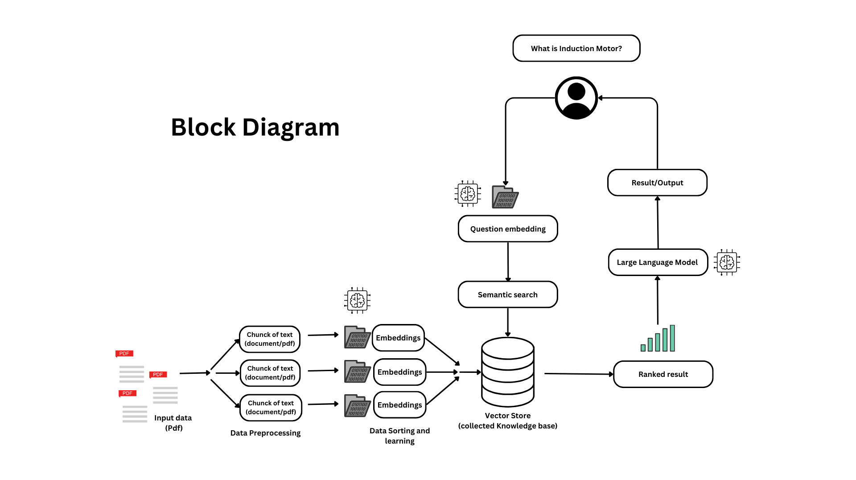

Slide 6
Methodology
1) Pdf Data Extraction:
We Begin by extracting text data from PDF documents to be incorporated into the knowledge base.
2) Data Chunking:
The Model break down the extracted text data into smaller, manageable chunks, ensuring they are of a reasonable size for processing.
3) Text Embedding:
Then the Model converts each data chunk into numerical embeddings using a suitable method, such as Word2Vec or Doc2Vec, to represent the semantic meaning of the text.
4) Knowledge Base Creation:
It stores these numerical embeddings in the knowledge base, associating each vector with its corresponding text chunk.
5) User Query Embedding:
When a user submits a query, employ the same text embedding method to convert the question into a numerical representation.

Slide 7
Methodology
6) Semantic Search:
The Model conduct a semantic search by comparing the user's query embedding with the embeddings of the PDF data chunks in the knowledge base to identify the most relevant data chunks.
7) Contextualization:
Then the model combines the identified data chunks into a contextualized context for the Large Language Model (LLM) to ensure it has the necessary information for a coherent response.
8) Ranking and Response Generation:
Rank the contextualized data chunks based on similarity, accuracy, and correctness. Provide the top-ranked data chunks as context to the LLM to generate a well-informed and contextually relevant response.
9) User Presentation:
The model displays the generated response to the user, offering precise answers to their questions derived from the semantically searched and contextually relevant data.

Slide 8
Tech Stacks
Tech | Discrption
langchain | Connects different language models and data sources
PyPDF2 | For encrypting or decrypting PDFs
python-dotenv | reads key-value pairs from a .env file and can set them as environment variables
streamlit | Turn data scripts into shareable web apps
openai | A deep learning model that can generate data from natural language descriptions
faiss-cpu | Library for efficient similarity search and clustering of dense vectors
tiktoken | For tokenizing text

Slide 9

Conclusion
In conclusion, "Mr.Volted" represents a groundbreaking advancement in the realm of electrical engineering education and research. With its locally curated data repository and advanced AI models from Langchain and OpenAI, it has the potential to revolutionize how knowledge is accessed, shared, and applied in this dynamic field. By prioritizing knowledge accessibility, "Mr.Volted" aims to make learning more efficient and research more productive for a wide range of users, from aspiring engineers to seasoned researchers. As we embark on this journey to enhance the electrical engineering landscape, "Mr.Volted" stands as a promising beacon of innovation, offering a reliable and locally sourced knowledge hub for enthusiasts and professionals alike, thereby shaping the future of electrical engineering education and research.

Slide 10
Resources
Research papers:
Chatting about ChatGPT: How May AI and GPT Impact Academia and Libraries? by Brady Lund, Wang Ting :: SSRN
(PDF) A Brief Review of ChatGPT: Its Value and the Underlying GPT Technology (researchgate.net)
The Future of GPT: A Taxonomy of Existing ChatGPT Research, Current Challenges, and Possible Future Directions by Shahab Saquib Sohail, Faiza Farhat, Yassine Himeur, Mohammad Nadeem, Dag Øivind Madsen, Yashbir Singh, Shadi Atalla, Wathiq Mansoor :: SSRN
ChatGPT: A comprehensive review on background, applications, key challenges, bias, ethics, limitations and future scope – ScienceDirect
Documentation:
https://python.langchain.com/docs/get_started/introduction.html
https://platform.openai.com/docs/introduction
https://www.python.org/doc/

Slide 11
— Mr.Volted
Thankyou

